Slide 1
Maze games

Slide 2
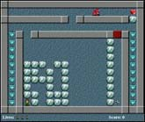
The Game Idea
Before starting creating a game we have to come up with an idea of what the game is going to be.
A good game is exciting, surprising and addictive.
There should be clear goals for the player, and the user interface should be intuitive.

Slide 3
The Game Idea
maze game
main object in the game is a person controlled by the player. Each room consists of a maze.
To escape the maze the player must collect all diamonds and then reach the exit.
To do so the player must solve puzzles and monsters must be avoided.
Many puzzles can be created: blocks must be pushed in holes; parts of the room can be blown away using bombs, etc.

Slide 4
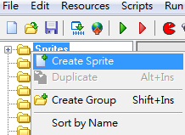
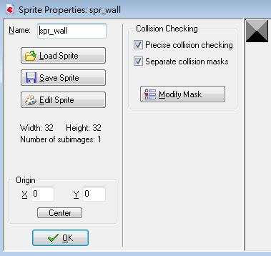

A Simple Start
The objects
There are three crucial ingredients in the game: the player, the wall, and the exit. We will need a sprite for each of them and make an object for each of them.
load maze_1.gmk.
Create these three sprites in the usual way and name them spr_person, spr_wall, and spr_goal.
Load Sprite
Sprites>Creat Sprite

Slide 5

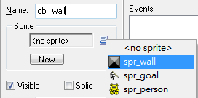
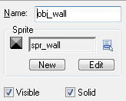
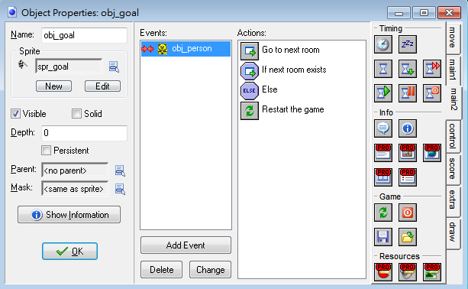
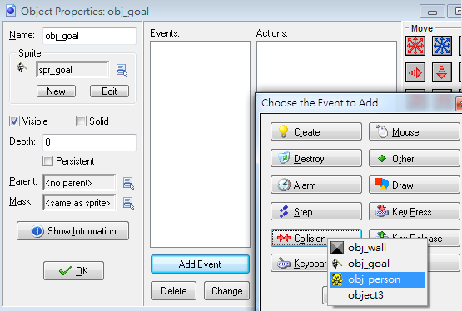
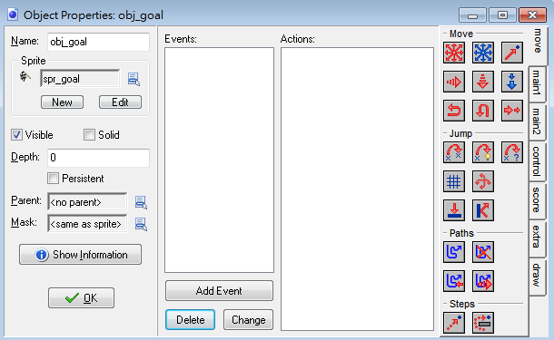
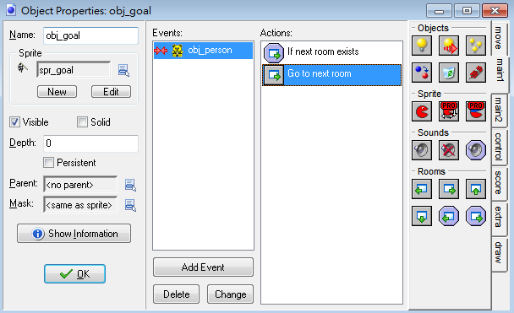
A Simple Start
Next we create three objects:
wall object: Creat Object>Name: obj_wall> Sprite: spr_wall 。
goal object: We decided to give it a picture of a finish flag. When the person collides with it we need to go to the next room.
we put this action in this collision event.
1.
3.
Add Event> obj_person
Name: obj_goal,
Sprite: spr_goal
main1>check next\ Go to next room
Control>ELSE
main2>Restart the game
2.

Slide 6
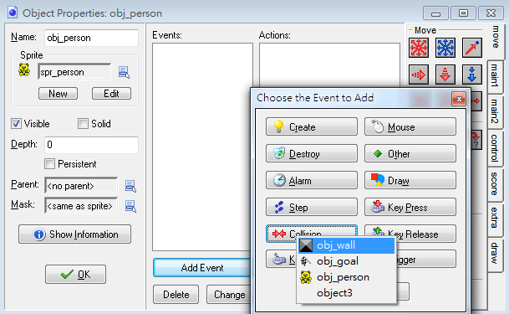
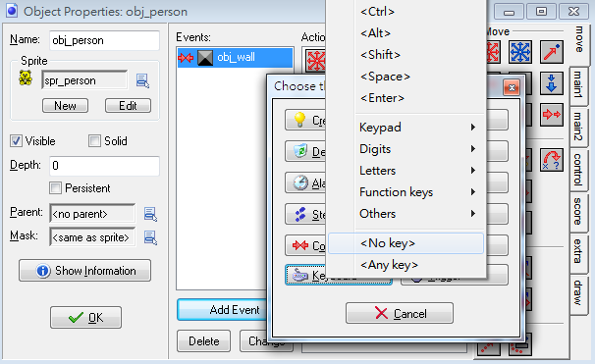
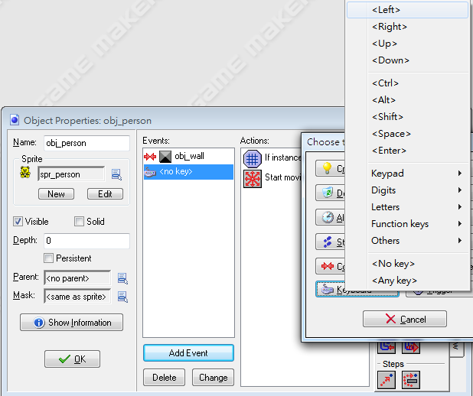
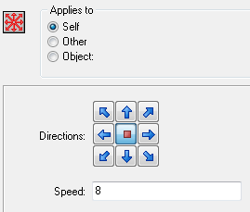
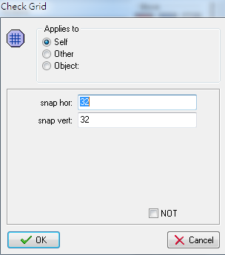
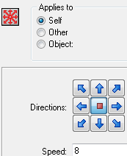
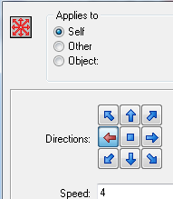
A Simple Start
person object: we need to create the person that is controlled by the player.
Creat Object>Name: obj_person> Sprite: spr_person
We will use the arrow keys for movement. There are different ways in which we can make a person move.
Name: obj_person, Sprite: spr_person
Add Event>Collision>obj_wall> Move Fixed
Actions for all for arrow keys
Left\Right\Up\Down
Action>Check Grid : use 32 and Move Fixed direction of motion :speed use 4
1.
Add Event> keyboard event for <no key>
Action>Check Grid , set the parameters to 32
and Move Fixed direction of motion :speed use 8
2.
3.

Slide 7
A Simple Start
There is one thing you have to be careful about here. If your person's sprite does not completely fill the cell, which is normally the case, it might happen that your character is not aligned with a grid cell when it collides with the wall.
In this case the person will get stuck because it won't react to the keys (because it is not aligned with the grid) but it can also not move further (because the wall is there).
The solution is to either make the sprite larger, or to switch off precise collision checking and as bounding box indicate the full image.

Slide 8
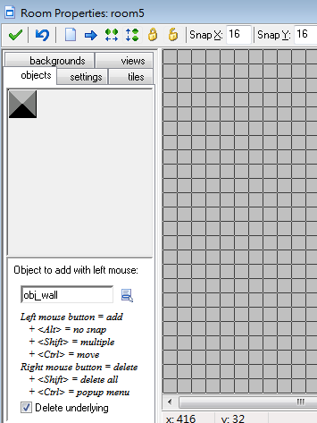
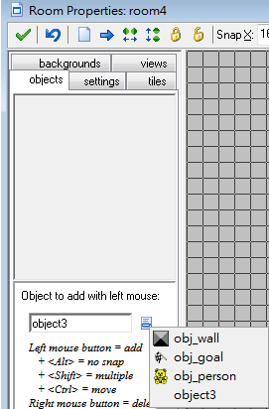
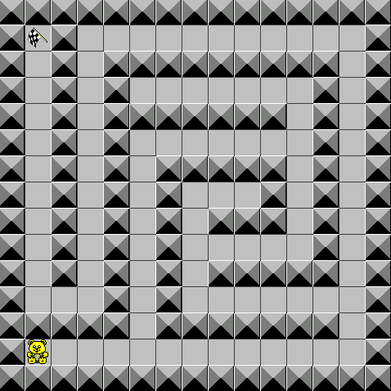
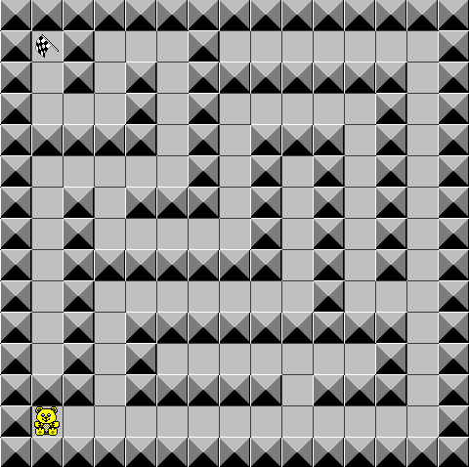
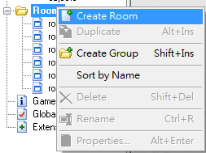
A Simple Start
Creating rooms
Create one or two rooms that look like a maze.
In each room place the goal object at the destination and place the person object at the starting position.
Room>Creat Room
Add wall
Add goal and person
Finish

Slide 9
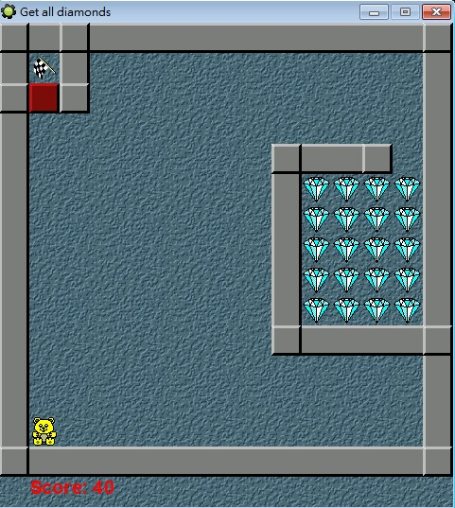
Collecting Diamonds
The goal of our game was to collect diamonds. But how do we make sure the player cannot exit the room when not all diamonds are collected?
To this end we add a door object. The door object will behave like a wall as long as there are still diamonds left, and will disappear when all diamonds have gone.
load maze_2.gmk.

Slide 10


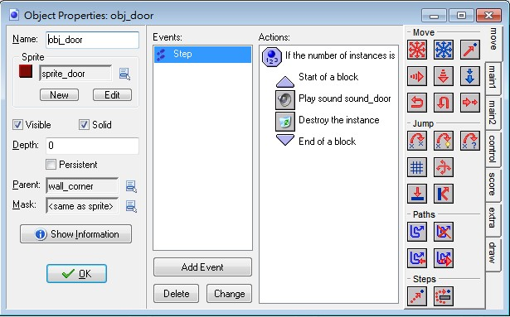
Collecting Diamonds
we need two more objects, with corresponding sprites: the diamond and the door.
Diamond: the only action it needs is that it is destroyed when the person collides with it. So in the collision event we put an action to delete it.
Door: the door object will be placed at a crucial place to block the passage to the goal.
check whether the number
of diamonds is 0 and,
if so, destroys itself.
play some sound.

Slide 11



Collecting Diamonds
Making it a bit nicer
make three wall objects:Give them the right sprites and make them solid.
corner
vertical walls
horizontal walls
To avoid having to specify collision events of the person with all these different walls (and later similar for monsters), we use an important technique in Game Maker.
We make the corner wall object the parent of the other wall objects.
So they have exactly the same behavior (unless we specify different behavior for them)

Slide 12
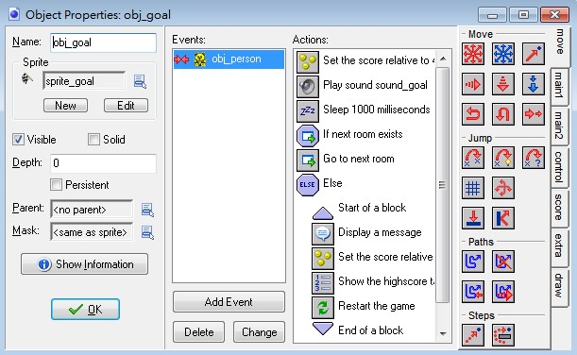
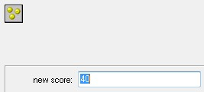
Collecting Diamonds
Score : Let us give the player a score
For each diamond destroyed we give 5 points.
Finishing a level gives 40 points vertical walls.
When the player reaches the last room a high-score table must be shown.
we set the font and color and then use the action to draw the score.
Score

Slide 13
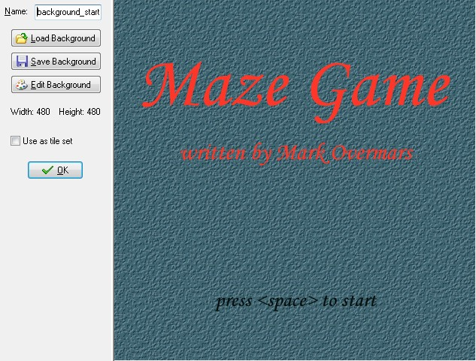
Collecting Diamonds
Starting screen
This background we use for the first room.
A start controller object is created that simply waits until the user presses a key and then moves to the next room. (The start controller also sets the score to 0 and makes sure that the score is not shown in the caption.)

Slide 14
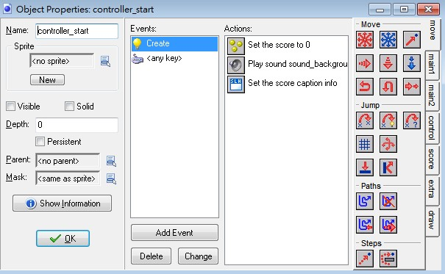
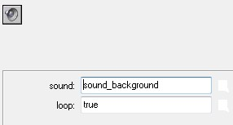
Collecting Diamonds
Sounds
First of all we need background music.
start_controller, looping it forever.
Next we need some sound effects for picking up a diamond, for the door to open, and for reaching the goal.
start_controller

Slide 15
Collecting Diamonds
Creating rooms
Now we can create some rooms with diamonds.
The first maze room without diamonds we can simply leave in.
This is good because it first introduces the player to the notion of moving to the flag, before it has to deal with collecting diamonds.

Slide 16
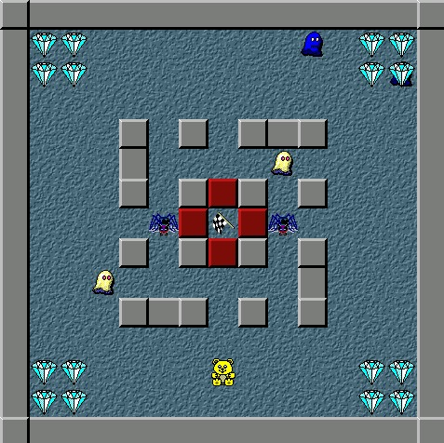
Monsters and Other Challenges
The game as it stands now starts looking nice, but is still completely trivial, and hence boring to play. So we need to add some action in the form of monsters. Also we will add some bombs and movable blocks and holes. The full game can be found in the file move_3.gmk.

Slide 17
Monsters and Other Challenges
Monsters
create three different monsters:one that moves left and right, one that moves up and down, and one that moves in four directions.
When the person hits a monster, it is killed, that is, the level is restarted and the player looses a life. We will give the person three lives to start with.

Slide 18
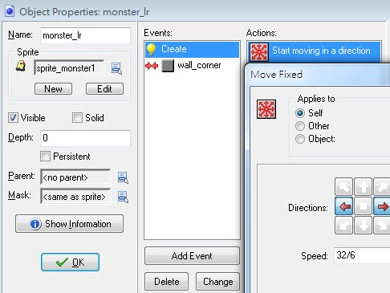

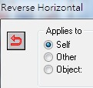
Monsters and Other Challenges
Monsters
first create the monster that moves left and right.
Also, to make life a bit harder, we set the speed slightly higher. When a collision occurs it reverses its horizontal direction.

Slide 19
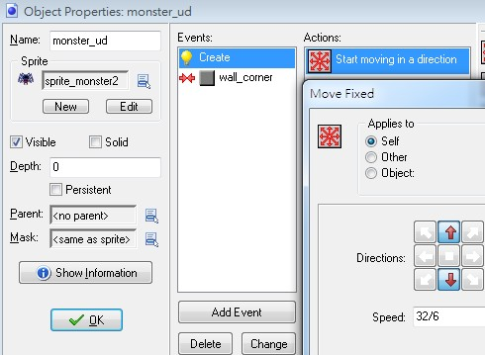

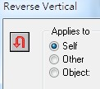
Monsters and Other Challenges
Monsters
The second monster works exactly the same way but this time we start moving either up or down and, when we hit a wall, we reverse the vertical direction.

Slide 20
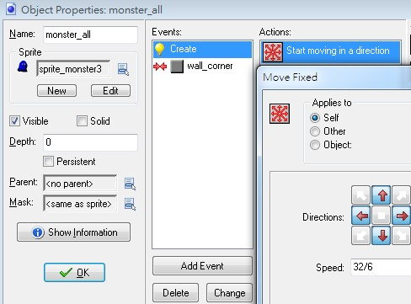
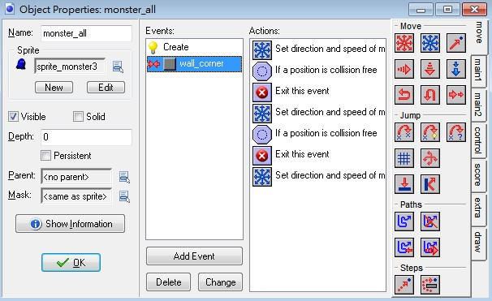

Monsters and Other Challenges
Monsters
The third monster. It starts moving either in a horizontal or in a vertical direction. When it hits a wall it looks whether it can make a left or a right turn. If both fail it reverses its direction. This looks as follows:

Slide 21
Monsters and Other Challenges
Monsters
To avoid problems with monsters being slightly too small, we uncheck precise collision checking and modify the mask to set the bounding box to the full image.
When the person collides with a monster, we have to make some awful sound, sleep a while, decrease the number of lives by one, and then restart the room.
Note that this order is crucial. Once we restart the room, the further actions are no longer executed
The controller object, in the "no more lives" event, shows the high-score list, and restarts the game.

Slide 22
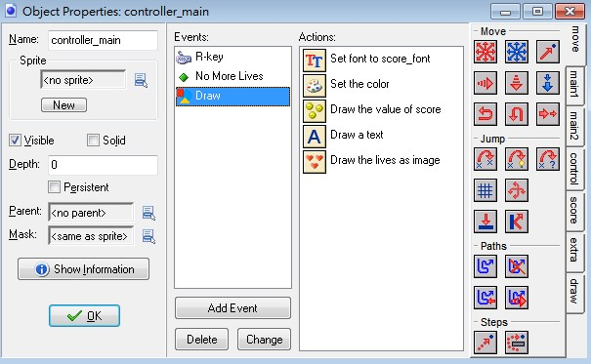
Monsters and Other Challenges
Lives
We used the lives mechanism of Game Maker to give the player three lives.
There is an action for this in the score tab.
Note that we also used a font resource to display the score.
The drawing event now looks as follows:

Slide 23
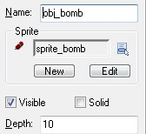
Monsters and Other Challenges
Bombs
Let us add bombs and triggers to blow them up.
This can be used to create holes in walls and to destroy monsters.
need three new objects: a trigger, a bomb, and an explosion.
For each we need an appropriate sprite.
a bomb: we set its depth to 10.
Object instances are drawn in order of depth. The ones with the highest depth are drawn first. So they will lie behind instances with a smaller depth. By setting the depth of the bomb to 10 the other objects, that have a default depth of 0, are drawn on top of it.

Slide 24
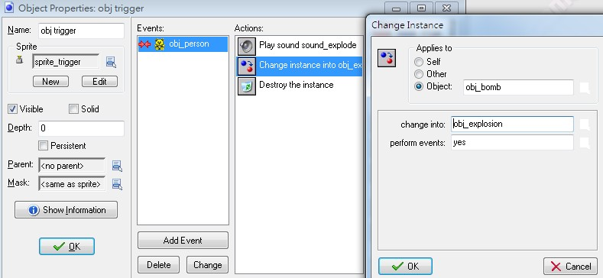
Monsters and Other Challenges
Bombs
a trigger : When it collides with the person it turns all bombs into explosions.
This can be achieved by using the action to change an object in another object. At the top we indicate that it should apply to all bombs.

Slide 25
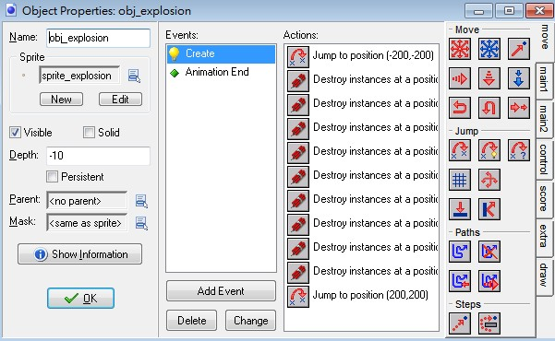
Monsters and Other Challenges
Bombs
a trigger : You have to be careful that the origin of the explosion is at the right place when turning a bomb into it.
First of all, we do not want the explosion to destroy itself so we move it temporarily out of the way.
Then we use actions to destroy all instances at positions around the old position of explosion.
Finally we place the explosion back at the original place.

Slide 26
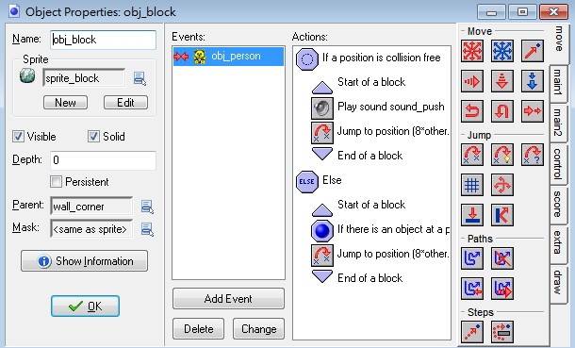
Monsters and Other Challenges
Blocks and holes
We create blocks that can be pushed by the player.
Also we make holes that the player cannot cross but that can be filled with the blocks to create new passages.
Blocks have to be pushed in a particular way to create passages. And you can catch monsters using the blocks.
We test whether relative position 8*other.hspeed, 8*other.vspeed is empty.

Slide 27
Monsters and Other Challenges
Blocks and holes
This is the position the block would be pushed to.
If it is empty we move the block there. We do the same when there is a hole object at that position.
To avoid monsters running over blocks we make the corner wall the parent of the block. Because a collision event is defined between the person and the corner wall and not between the person and the block, that event is executed, stopping the person.

Slide 28
Monsters and Other Challenges
Blocks and holes
This is not what we want. To solve this we put a dummy action (just a comment) in the collision event of the person with the block. Now this event is executed instead, which does not stop the person. (To be precise, the new collision event overrides the collision event of the parent. As indicated before, you can use this to give child objects slightly different behavior than their parents.
To solve this we put a dummy action in the collision event of the person with the block.
The new collision event overrides the collision event of the parent. As indicated before, you can use this to give child objects slightly different behavior than their parents.

Slide 29
Monsters and Other Challenges
Blocks and holes
With the blocks and holes you can create many intriguing rooms.
we need to give the player the possibility to restart the level, at the cost of one life. To this end we use the key R for restart.
In this keyboard event for the controller we simply subtract one from the lives and restart the room.

Slide 30
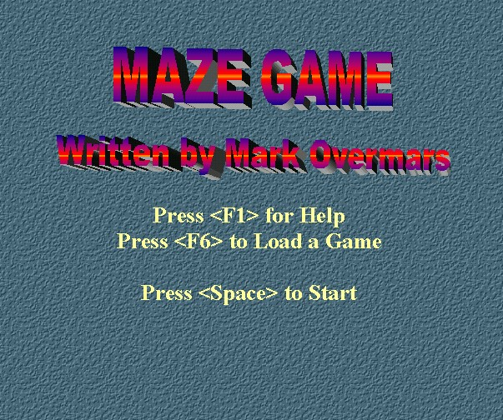
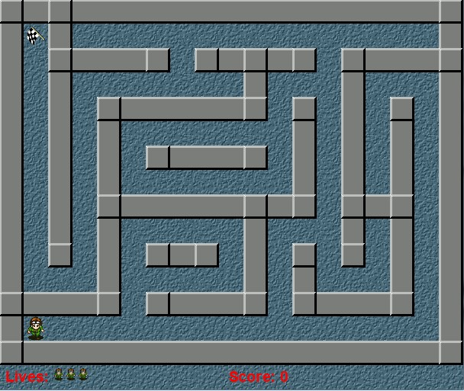
Some Final Improvements
We definitely should improve the graphics.
Also we need a lot more interesting levels.
To do this we add some bonuses and add a few more features.
The final game can be found in the file maze_4.gmk.

Slide 31
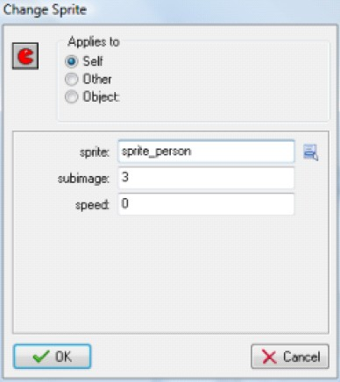
Some Final Improvements
Better graphics
The easiest way to achieve this is to use a new image that consists of 4 subimages, one for each direction.
Normally Game Maker cycles through these subimages.
setting the variable image_speed to 0. When we change the direction of the character, we can change the subimage shown by the action to change the sprite:

Slide 32
Some Final Improvements
Bonuses
add two bonuses: one to give you 100 points and the other to give you an extra life.
When they meet the person they play a sound, they destroy themselves, and they either add some points to the score or 1 to the number of lives.
One way streets
we make four objects, each in the form of an arrow, pointing in the directions of motion.
We check whether the person is aligned to the grid in the right way and whether in meets the particular arrow. If so, we set the motion in the right direction. (We set it to a speed of 8.)

Slide 33
Some Final Improvements
Frightened monsters
give every monster a variable called afraid.
we set it to 0 (false). When the person meets a new ring object we set the variable to true for all monsters and we change the sprite to show that the monster is indeed afraid.
Now when the person meets the monster we first check whether it is afraid or not.
If it is afraid the monster is moved to its initial position.
Otherwise, the player looses a life. See the game for details.

Slide 34
Some Final Improvements
Now let’s make a game out of it
Game Maker has a built-in load and save mechanism
F5 saves the current game.
F6 loads the last saved game.
Please load maze_4.gmk. Play it, check it out, and change it as much as you like.
You should add many more levels.
Also you can add some other objects, like e.g. keys that open certain doors, transporters that move you from one place in the maze to another, bullets that the person can shoot to kill monsters, doors that open and close from time to time, ice on which the person keeps moving in the same directions, shooting traps, etc.

